Slide 1
Socıalendar
By:
Yunus Güngör
Sinan Kartal
Mustafa Sağlam
M. Enes Kayılıoğlu
Recep Can Babaoğlu
Project Presantatıon

Slide 2


What Did We Plan?
Scope:
Socialander is an event based chat application for Android and iOS
Users attending to the same event grouped in a chatroom
Events taken out of device calendar so everything automatic and user does not show any effort to make things happen
Description:
The Socialendar application can bring together people who will same events efficiently, easily and precisely. These people are using mobile phone calendar and this app brings together these people in a chatroom if they want. User only need to login to add a new event or to edit current events. Then application take users in a chat room and provide users a communication channel. Users can sign up and sign in with Facebook, Google and mail accounts and application will take their events from device calendar or Facebook. The Socialendar is a JavaScript based application that uses React-Native for mobile phones which have iOS and Android. The application will interface with and utilize third party resources to facilitate all the users’ meeting scheduling needs (e.g. database services, email communication, etc.).

Slide 3
Our Team
Team Leader
(Yunus Güngör)
Cloud Developer
(Mustafa Sağlam)
UI Developer
(Recep Can Babaoğlu)
Full Stack Developer
(Mehmet Enes Kayılıoğlu)
Full Stack Developer
(Sinan Kartal)

Slide 4
What Did We Plan?
Work Breakdown Structure
Number of work package | Task | Assigned to | Epic | Dependence to work package | Size
1 | Firebase, React native setup | Member 1 | 7 |  | S
2 | Adding necessary modules and libraries | Member 1 | 7 | 1 | S
3 | Authentication | Member 1 | 6 | 2 | M
4 | User log in and log out | Member 1 | 6 | 2 | M
5 | Sign in with Facebook | Member 1 | 6 | 3 | M
6 | Sign in with Google | Member 1 | 6 | 3 | M
7 | Sign in with Mail | Member 1 | 6 | 3 | M
8 | Adding new user on database | Member 1 | 6 | 2 | M
9 | Checking authentication status | Member 1 | 6 | 3 | M
10 | Getting event information from device calendar | Member 2 | 3 | 2 | M
11 | Getting access to Facebook events of user | Member 2 | 3 | 2 | M
12 | Getting data from Facebook events | Member 2 | 3 | 11 | M
13 | Parsing Facebook event data and synchronization | Member 2 | 2 | 12 | M
14 | Synchronization between calendar and online database | Member 2 | 2 | 10 | M
15 | Matching events that occur at the same time on cloud | Member 3 | 5 | 14 | M
16 | Calculating a point between events occur at the same time | Member 3 | 5 | 15 | M
17 | Matching events that has close points | Member 3 | 5 | 16 | T
18 | Creating chat structure | Member 4 | 4 | 3 | L
19 | Being able to send message | Member 4 | 4 | 18 | M
20 | Being able to receive message | Member 4 | 4 | 19 | M
21 | Being able to create chatrooms between users | Member 4 | 4 | 20 | M
Number of work package | Task | Assigned to | Epic | Dependence to work package | Size
22 | Being able to add more than one user to chatrooms | Member 4 | 4 | 21 | M
23 | Creating chatrooms for matched events | Member 3 | 5 | 22,17 | S
24 | Adding events to calendar | Member 2 | 3 | 2 | M
25 | Adding events to database | Member 2 | 3 | 2 | M
26 | Creating add event ui | Member 5 | 1 | 24 | S
27 | Organizing and polishing add event ui | Member 5 | 1 | 24 | L
28 | Creating ui to view events | Member 5 | 1 | 14 | S
29 | Organizing and polishing view event ui | Member 5 | 1 | 14 | L
30 | Creating home screen ui | Member 5 | 1 |  | M
31 | Creating a function to access recent messages | Member 4 | 4 | 22 | M
32 | Showing recent messages on home screen | Member 4 | 1 | 22 | S
33 | Showing events on home screen | Member 3 | 1 | 14 | M
34 | Creating a function to calculate next empty time of the user | Member 2 | 3 | 14 | M
35 | Showing next empty time on home screen | Member 3 | 1 | 24 | S
36 | Creating chat ui | Member 5 | 1 | 20 | M
37 | Organizing and polishing style of chat ui | Member 5 | 1 | 20 | M
38 | Being able to see weather forecast on event time | Member 5 | 1 | 29 | M
39 | Optimizing event points | Member 3 | 5 | 17 | L
40 | Coding event editing function on calendar | Member 3 | 3 | 10 | M
41 | Coding event editing function on database | Member 4 | 2 | 10 | M
42 | Creating event editing ui | Member 4 | 1 | 41,40 | M

Slide 5

What Did We Plan?
Deliverables:
Mobile Application
Project Plan
Project Requirement
Project Design
Mobile Application Source Code

Slide 6
What We Did?
Deliverables
Mobile Application
Only a part delivered
Project Plan
Delivered
Project Requirement
Delivered
Project Design
Delivered
Mobile Application Source Code
Only a part delivered
Customer Meetings
1 meeting with group
2 meeting with group leader
Work Packages
9 out of 42 work packages completed
Most of the components did not implemented
Live Demo
Users can login to the application
Overall: Project is Failed

Slide 7
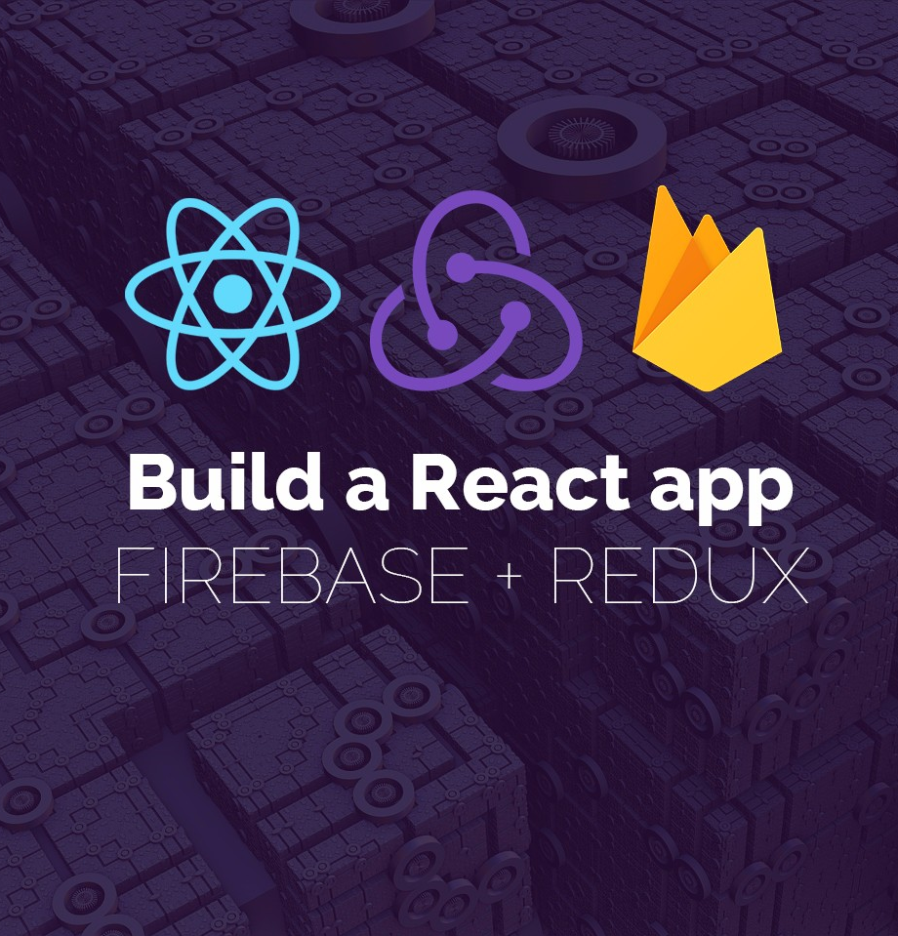
How did we Implement?
React Native
Redux
Firebase
And other react packages:
React Native Calendar Events
React Native Device Info
Facebook and Google API’s for sign in
Weather API

Slide 8

React Native
React Native is a framework for building native applications for Android and iOS with JavaScript and React.
Why React Native ?
Easy to code
Using ES6 Syntax of JS, most of the can be done asynchronously which means butter smooth UI
Implementing an UI design is pretty easy
Supports object oriented approach but does not have any structure to hide data
No application wide structure for storing context – Solved by Redux
Every component acts as a one page application of its own therefore there is no navigation – Solved by React Native Router Flux

Slide 9

Redux
Redux is a React component that creates an application wide state for use with any component
How to Redux?
Redux has a structure that separates data and functions. This approach is very useful for application state
Data called reducer in redux
Functions that interacts with data (read or write) called actions
Every time an action called a new state created this very useful when debugging application

Slide 10

Firebase is a web service for application development backend. Firebase provides database, authentication server, storage and statistical tracking tools
Why Firebase?
Easy to code
Easy to provide security
Easy to authenticate users
Real time database – Very important for chatting
Cloud functions written in JS

Slide 11
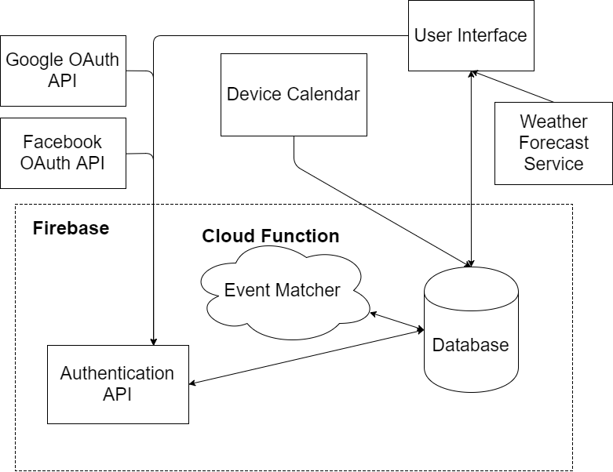
system
architecture

Slide 12
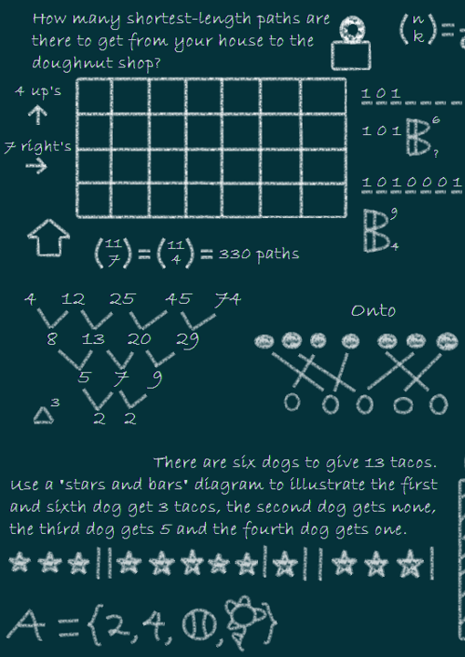
Heart of the application: Event Matching Algorithm
Each event has a globalId value that matches with a chatroom
Algorithm creates a matching point between events (likelihood)
Matching point created according to the event’s name and similarities in name
A threshold value used for eliminating non similar events
Event migrates highest point’s globalId
If there is no event left after thresholding, a new globalId and chatroom created
This algorithm has been planned to run on the cloud automatically

Slide 13

Other aspects of the application:
Besides Event Matching application mostly acts as a data input output process. Most of the components take data from a source and redirects it to another source.
Those sources might be
User
Device Calendar
Database
Forecast Service

Slide 14
Testing
Only implemented module was login module
This module tested manually due to high dependence to the other APIs and User Interface
Test Cases
Login with a nonexistent user
Sign up as a new user
Login with a wrong password
Login with an existing user
Sign Up with Google
Sign Up with Facebook
Login with Google
Login with Facebook
Login with Google to an account signed up with Facebook
Login with Facebook to an account signed up with Google
Login automatically with previously authenticated device

Slide 15

How we failed?
Lack of team work. Our team working together for the first time.
Lack of time. There is simply not enough time catch up with every project student has.
Lack of ambition. Since this is a mandatory assignment without no benefit other than grade and knowledge participants was not ambitious.
Lack of supervising. Since each member is an equal member of team, there was nobody to enforce rules and push team members. Consider that team leader has no power besides telling people `can you do this in time please`.
Lack of self management. Since each member is an independent student, each member supposed to manage themselves to achieve deadlines on schedule. But this did not happen

Slide 16

Risks that come true
Wrong time estimation (risk no 1 in project plan)
Low communication in team (risk no 6 in project plan)
Steps are not tracked properly (risk no 9 in project plan)

Slide 17
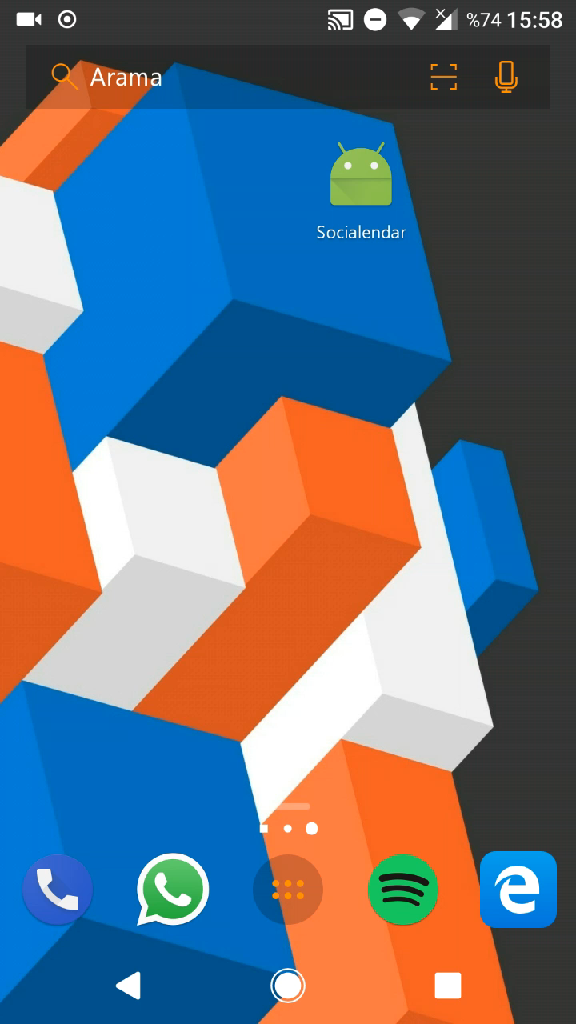
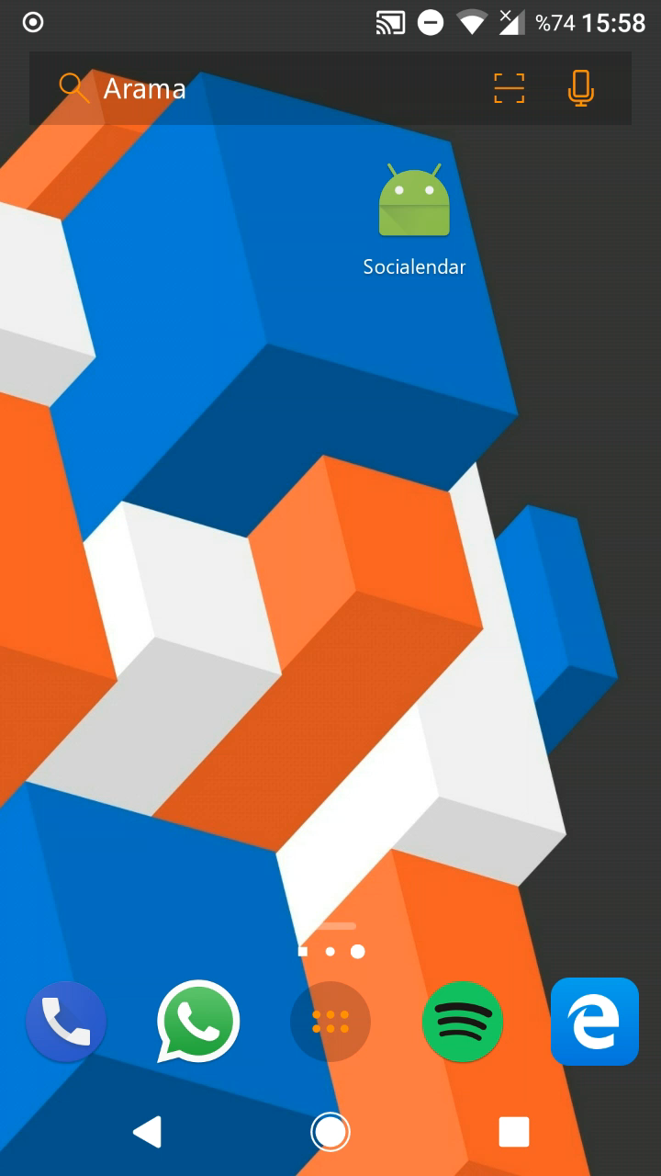
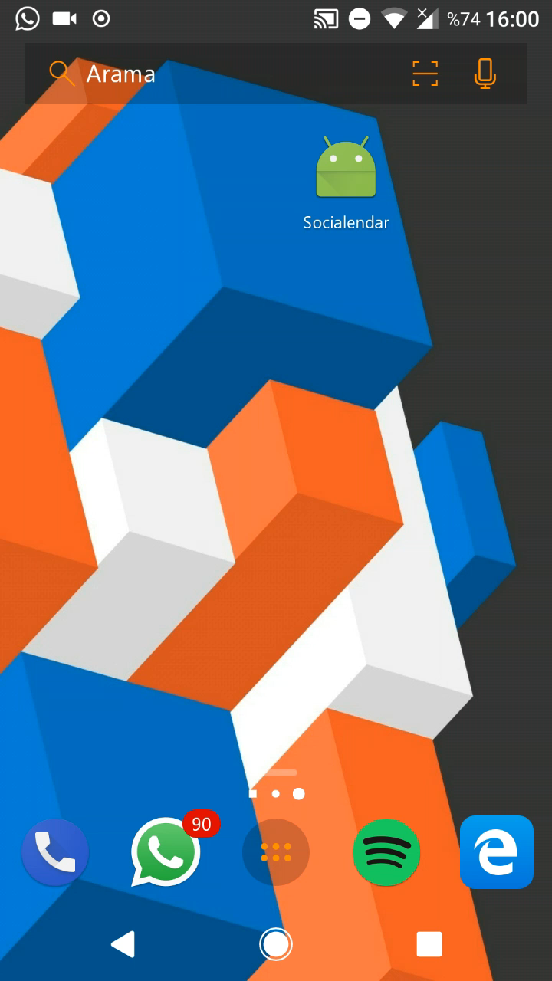

Demo

